Slide 1
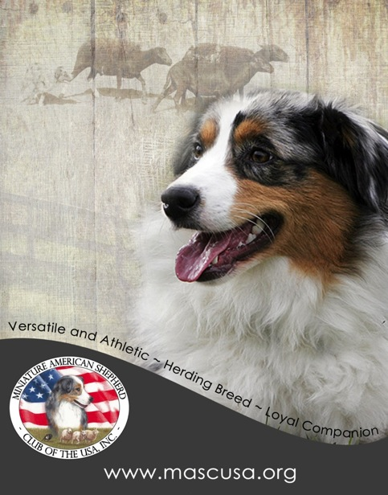
The
Miniature
American Shepherd
Breed Standard Education Presentation

Slide 2
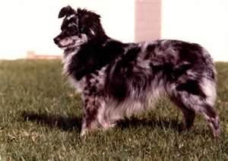
Origin: U.S.A.
1980: The National Stock Dog Registry (NSDR) allows Cordova’s Spike to register as the first Miniature Australian Shepherd. The small size quickly gains popularity throughout the USA, largely due to the community of horse owners attending rodeos and horse shows.
Cordova’s Spike
MASCUSA was incorporated in 1993 as a Registry and Parent Club for the Miniature Australian Shepherd.
In May 2011, AKC accepted the Miniature American Shepherd as a new breed and MASCUSA was selected as the parent club.
July 1st, 2015, the Miniature American Shepherd became fully recognized in AKC and advanced into the Herding Group.

Slide 3
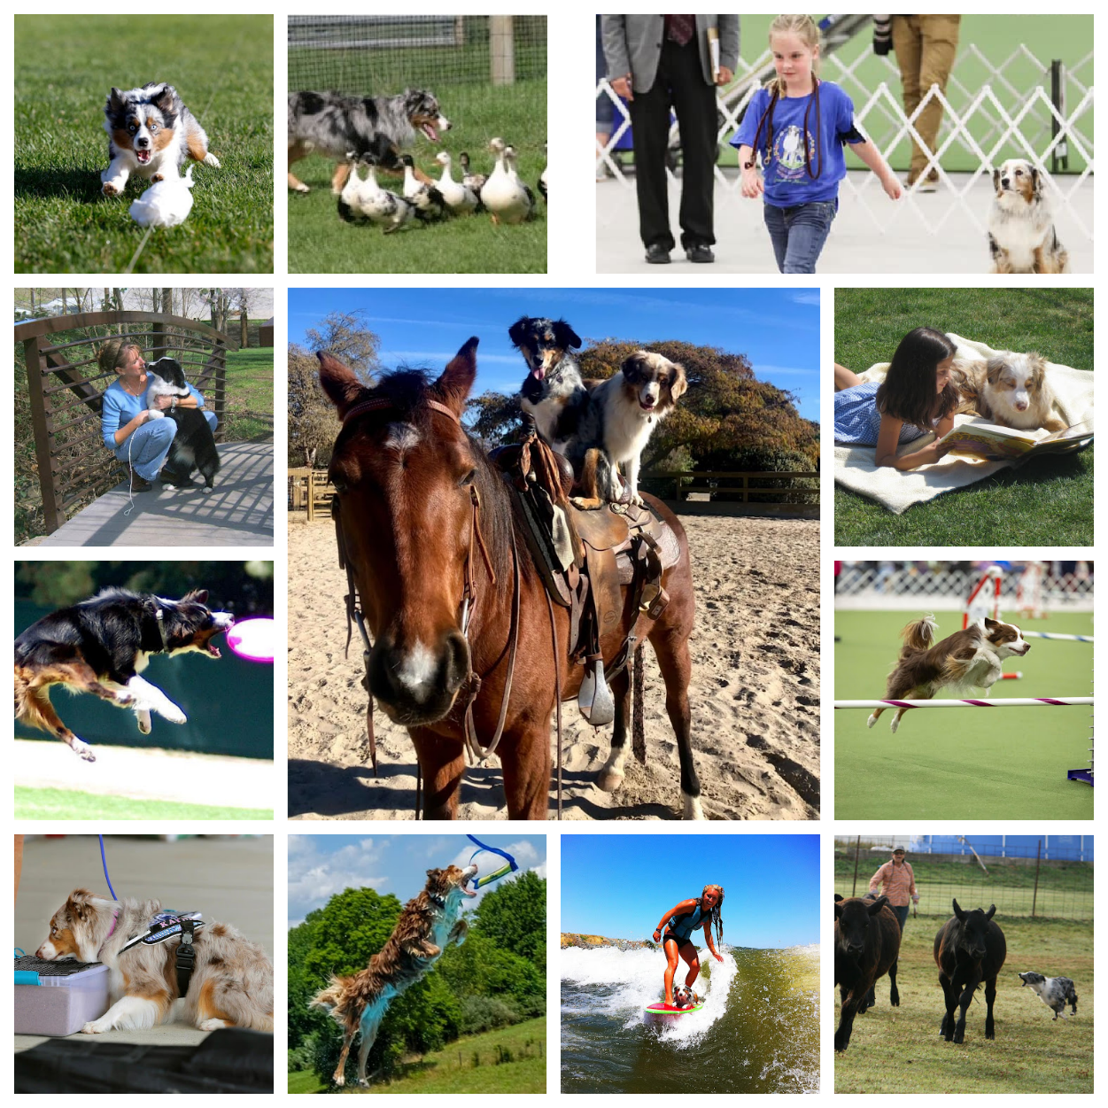
Our Versatile Heritage
The Miniature American Shepherd has the willingness and versatility to be a loyal family companion, herd livestock and excel in AKC events and other venues.
They can easily succeed in events such as Rally, Obedience, Fast Cat, Agility, Dock Diving, Barn Hunt, Carting, Disc Dog and more.

Slide 4
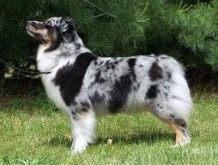
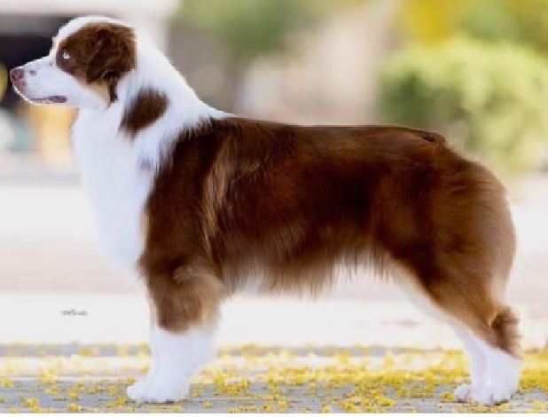
General Appearance
Slightly longer than tall
Moderate bone in proportion to body without extremes
Smooth, easy & well-balanced gait
Versatile and exceptionally agile with strength & stamina
Devoted and a biddable worker with superior intelligence
Loyal companion with a watchful expression
Medium length double coat
Coloring offers variety and individuality
Docked or natural bob tail is preferred

Slide 5
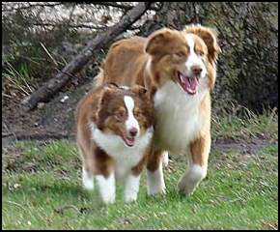
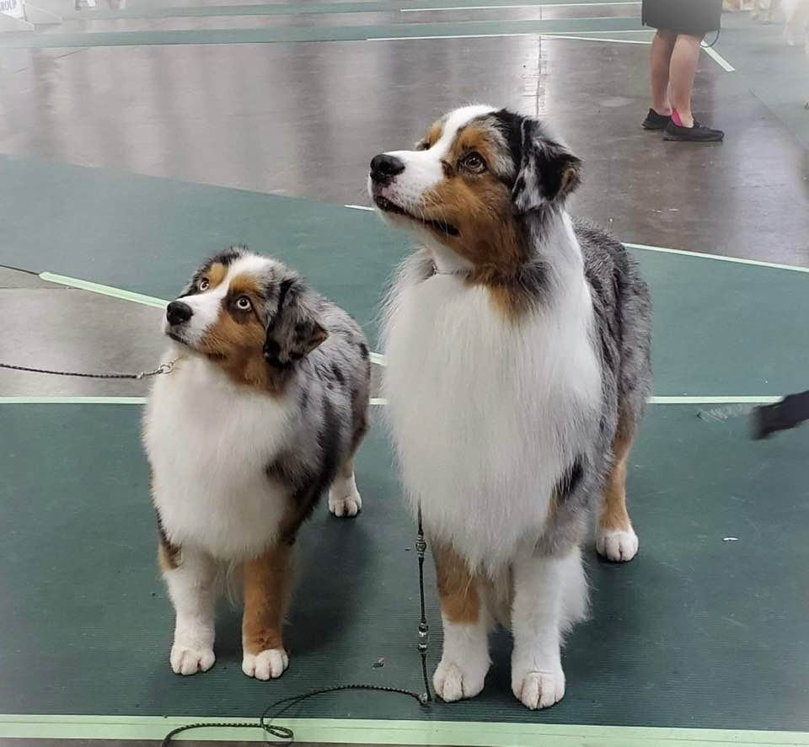
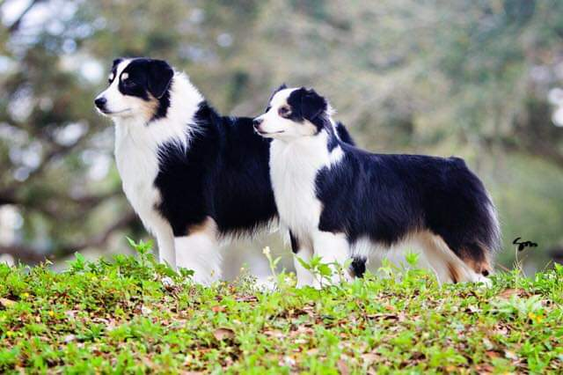
Height
No preference to size within the standard
13” - 17” Bitches
14” - 18” Dogs
Measure rather than withhold proper placement because of perceived size
17.5”
13”
18”
MAS/Aussie

Slide 6
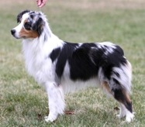
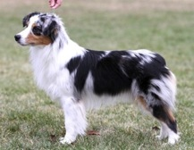

Important Proportions
Square
Correct
Too Long
Slightly Longer than Tall—measuring from the point of the shoulder to the point of the buttocks and from the highest point of the shoulder blade to the ground

Slide 7
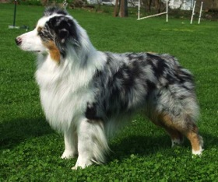
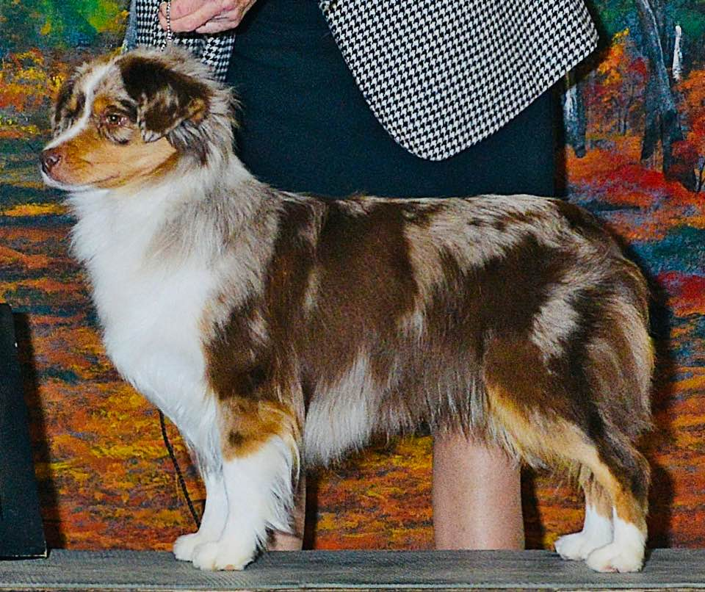
Substance
Blue Merle Male
Red Merle Female
Solidly built with moderate bone in proportion to body height and size.
Dog appear masculine without coarseness. Bitches appear feminine without being slight of bone.
Hair may add or detract from the appearance of the amount of bone/substance an animal has.
The breed does NOT have a heavy or stocky build, but it is a sturdy breed with a solid build that can work over a variety of terrain with agility and stamina. The breed is not exaggerated nor extreme in any way. Smaller sized dogs may not have the same amount of bone as larger sized dogs, but all sizes appear athletic and capable of performing various farm tasks.

Slide 8
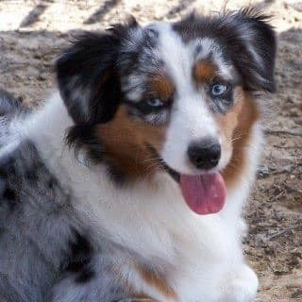
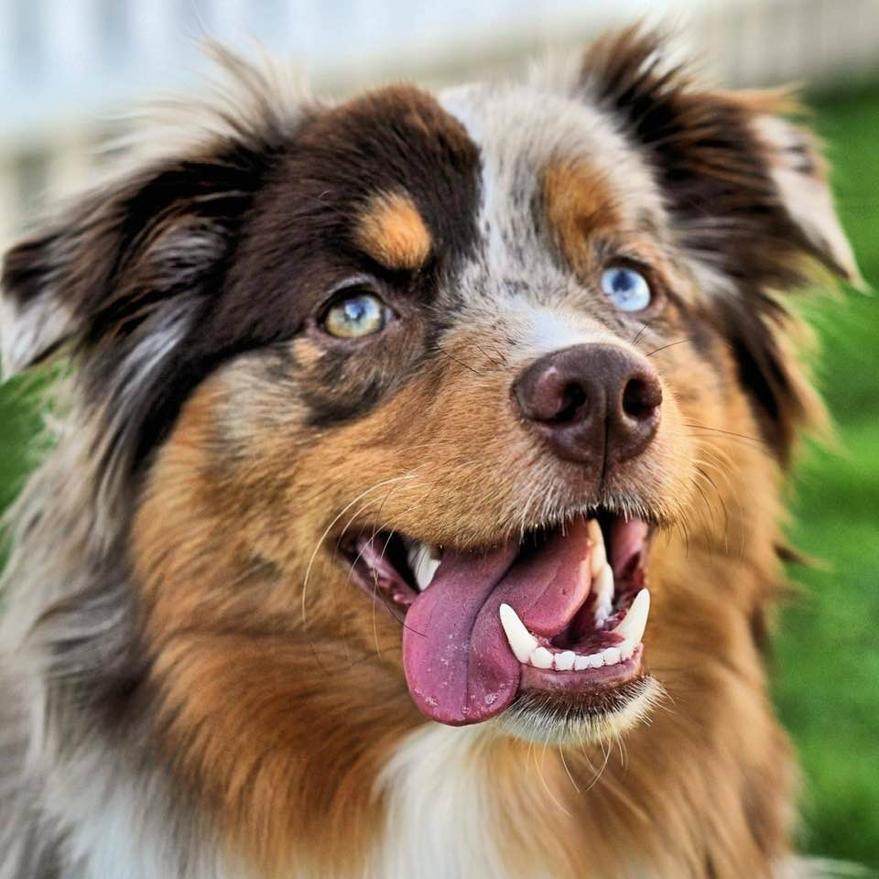
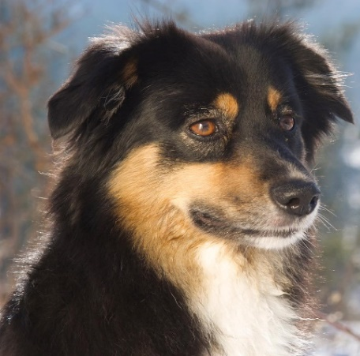
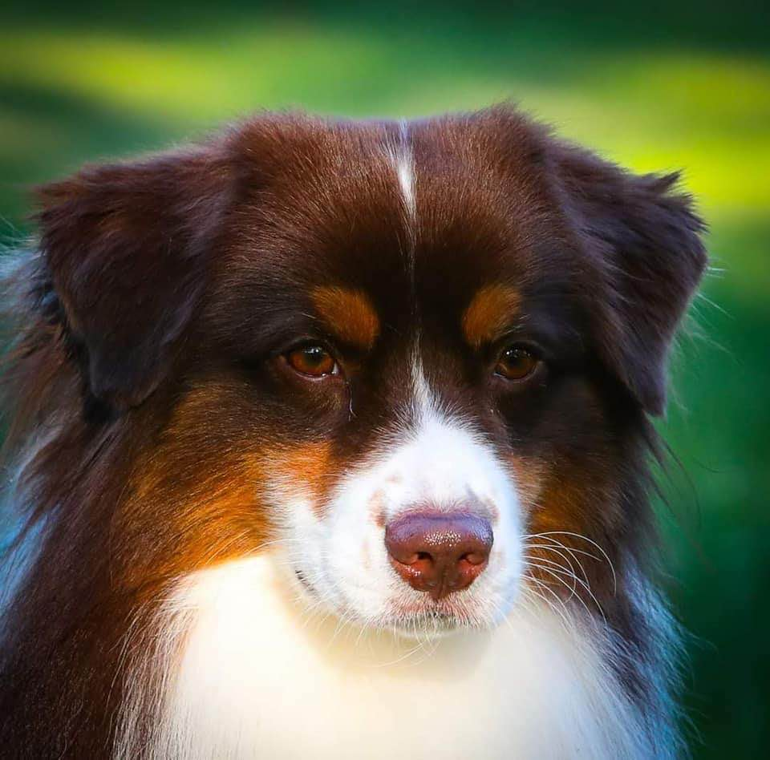
Head: Female and Male
Female
Male
The head shall be smooth, clean of excessive skin, tight and strong, without being coarse or over refined.
It should also be in proportion to the body and according to sex and substance of the dog.
Faults would include loose, wet flews and droopy eyelids.

Slide 9
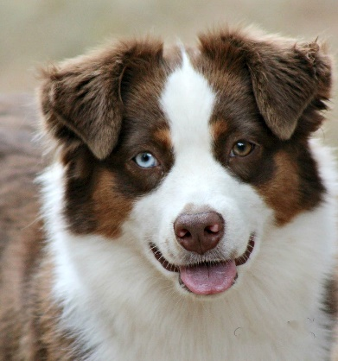
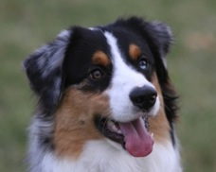
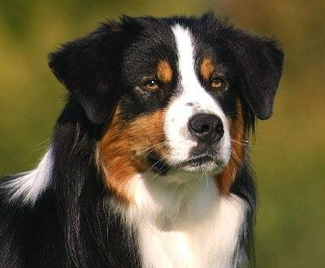
Expression
Alert
Attentive
Intelligent
Watchful
The breed can be reserved with strangers and may not acknowledge a judge who is trying to get their attention.
Although the MAS reserves his affections for those he knows and trusts, he should be accepting of a judge's touch. In the ring he should be attentive to his handler. The gaze is eager and intelligent. During the individual table examination, the judge should not expect or try to get "expression" from the dog. Expression is better assessed on the floor where the dog is in a more neutral setting.
Ear styles and/or the eye colors can also affect the expression, so it is important to understand that “Expression” is NOT a key factor during judging.

Slide 10
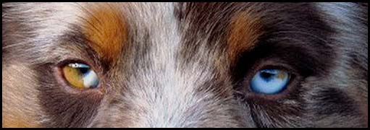
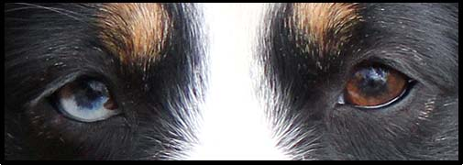
Eyes
Brown, blue, hazel, amber or any variation or any combination including flecks and marbling (one or both eyes)
Almond shaped, not protruding nor sunken, set obliquely
Blue merles and blacks have full black pigmentation on eye rims
Red merles and reds have full red (liver) pigmentation on eye rims
Each eye is surrounded with hair color other than white
Eye color does not have to correspond with coat color

Slide 11
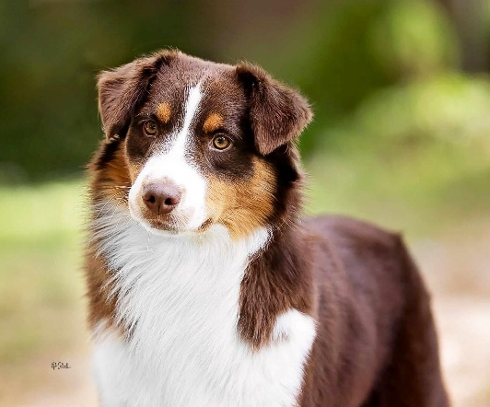
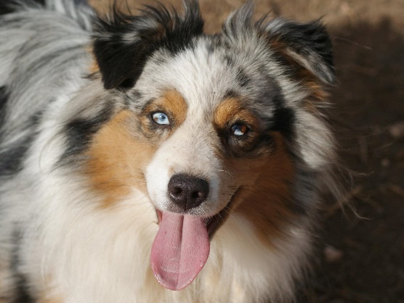
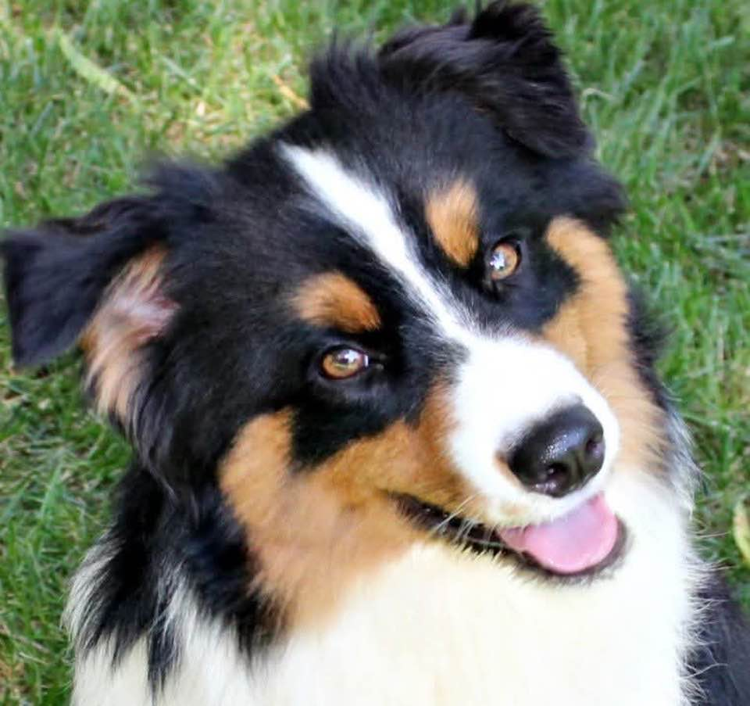
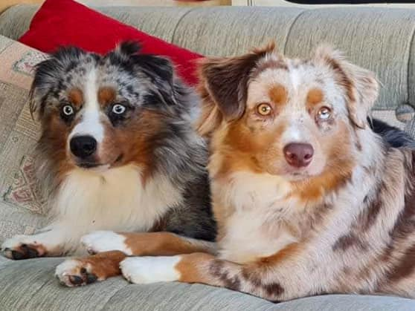
Ears
Triangular
Moderate size
Set high on head
At full attention ears break forward and over, or to the side as a rose ear
May have two different ear sets on one dog.

Slide 12
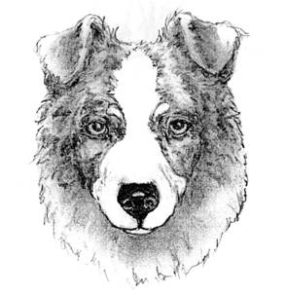
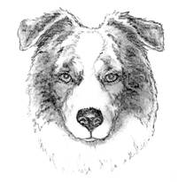
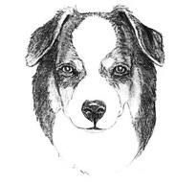
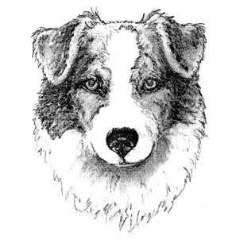
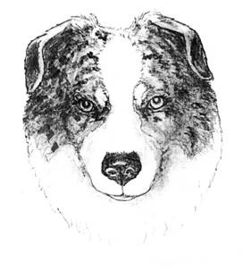
Ears: Acceptable Styles
It is important for ears to be of a medium size, triangular in shape and to set high on the head and for the ears to have some amount of lift at the base. All ear styles are equally correct
Illustrations courtesy of Vicky Mistretta

Slide 13
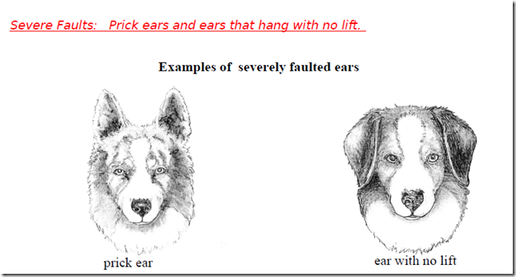
Ears: Severe Faults
Illustrations courtesy of Vicky Mistretta

Slide 14
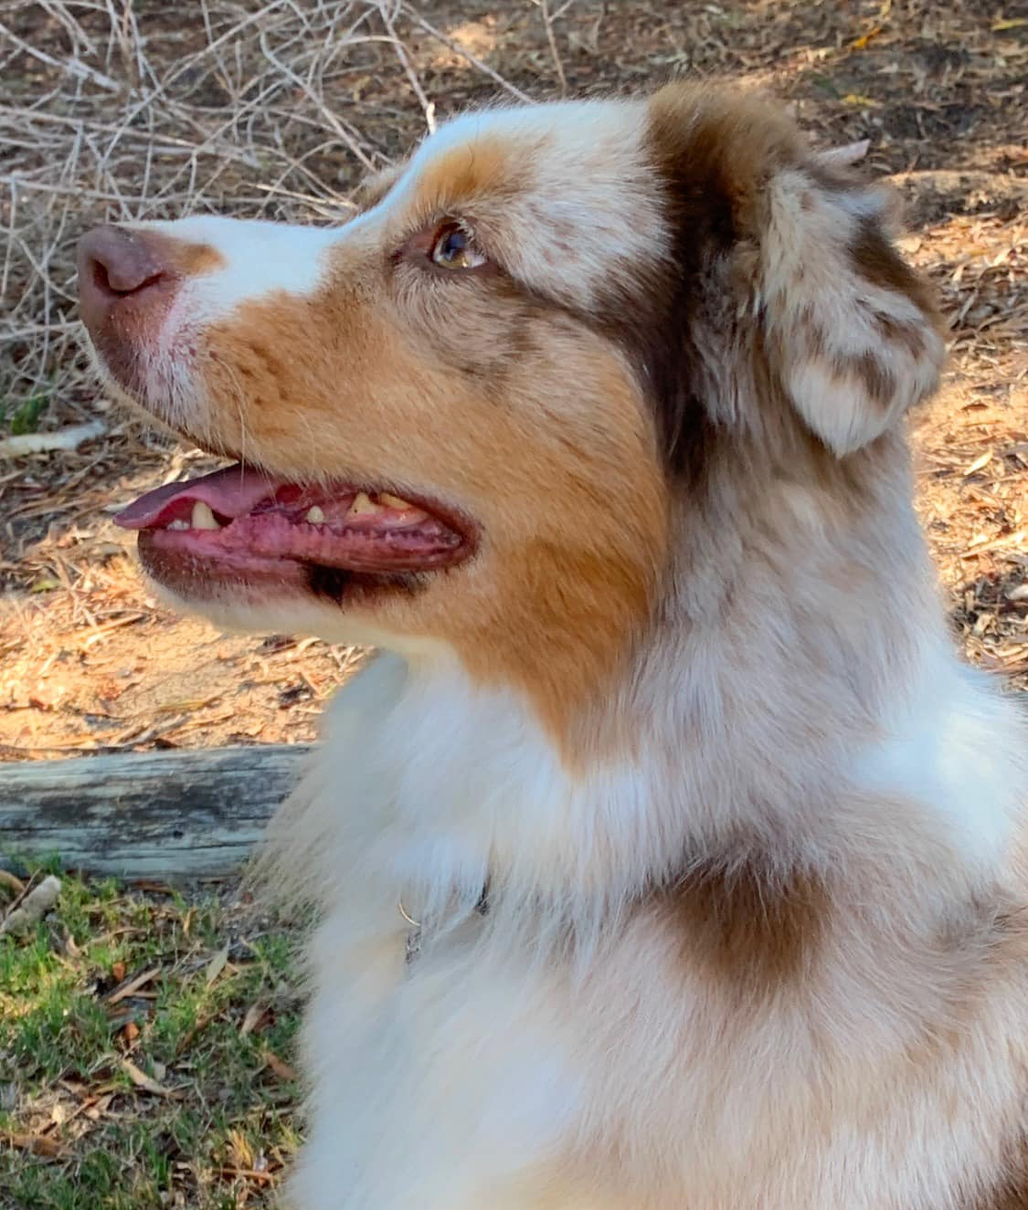
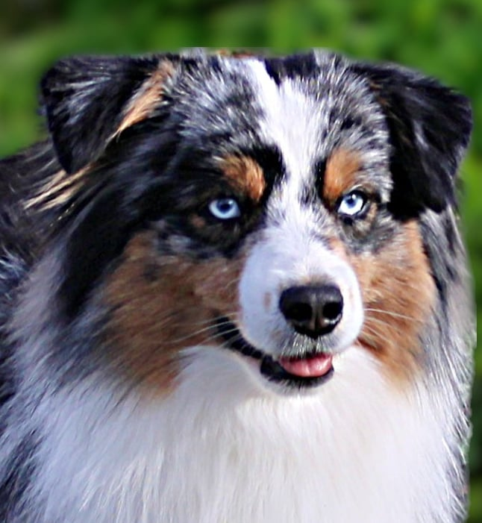
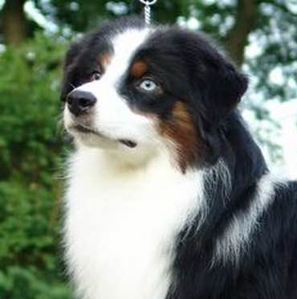
Skull
Crown: top flat to slightly round. It may show a slight occipital protuberance
The width and the length of the crown are equal

Slide 15
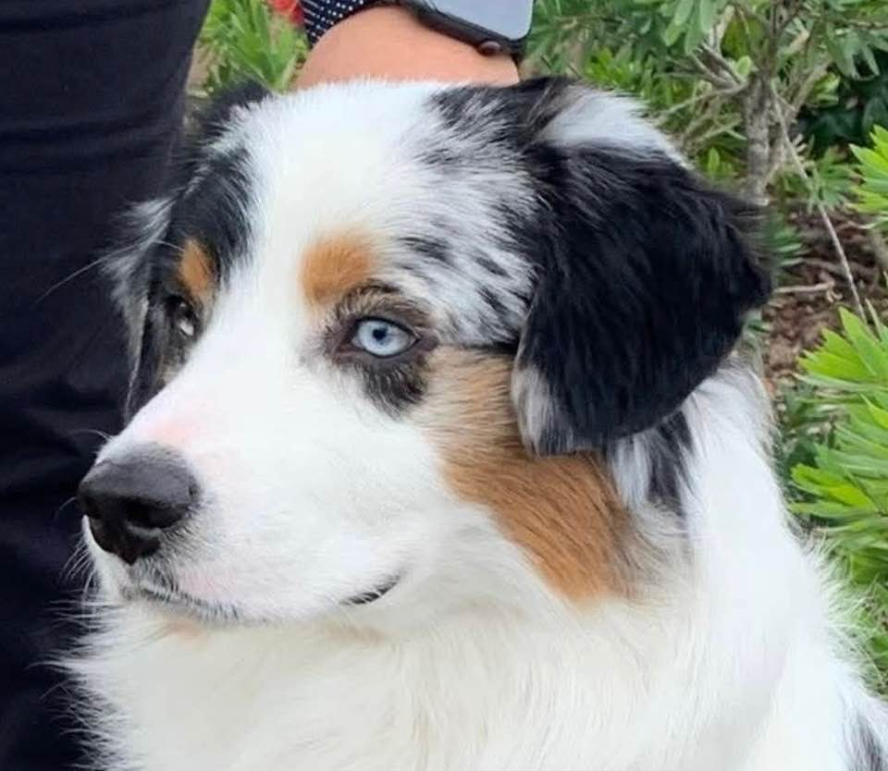
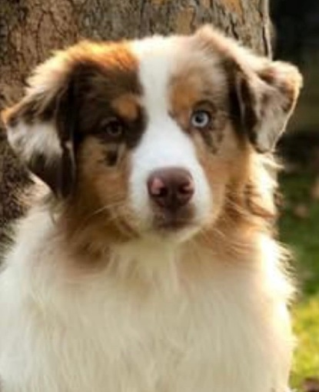
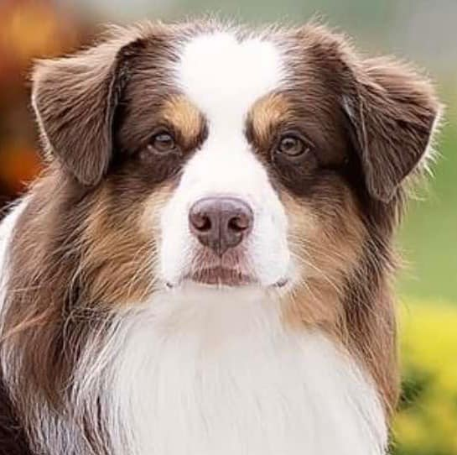
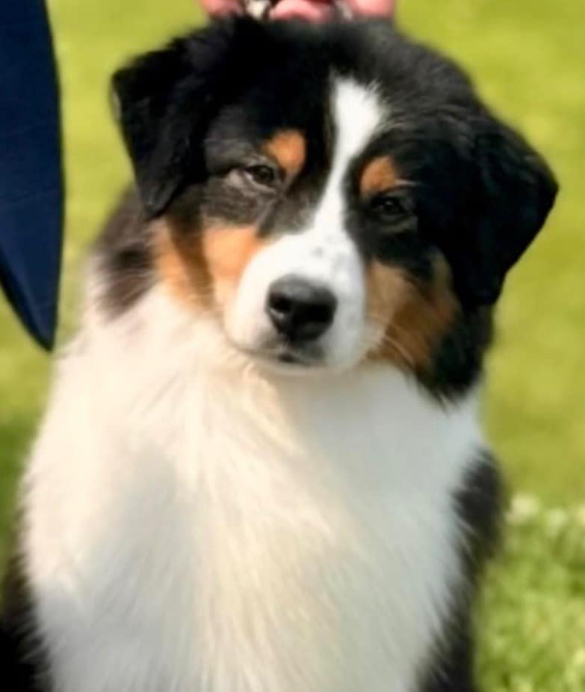
Stop & Muzzle
Stop:
Moderate, but defined
Keep in mind that the angle of the stop must allow for a kick to glance off
Muzzle:
Medium width and depth
Tapers gradually from base to nose and is rounded at the tip

Slide 16
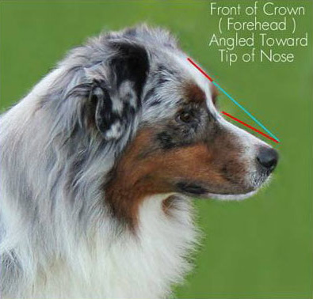
Head Planes
Viewed from the side, muzzle and top line are slightly oblique to each other
The front of the crown is on a slight angle downward toward the nose

Slide 17
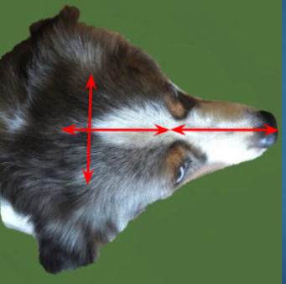
Head Proportions
Length of muzzle is equal to the length and width of the crown

Slide 18
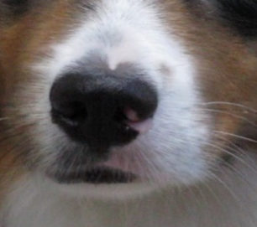
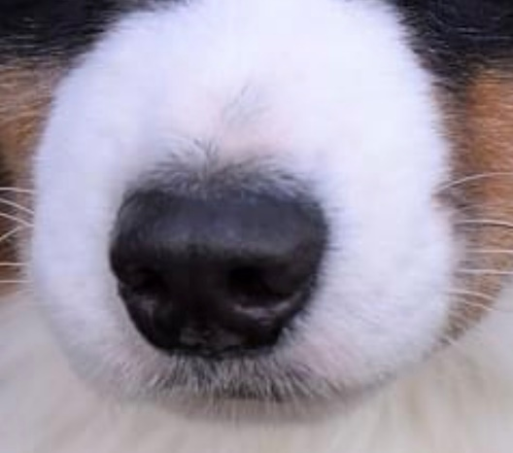
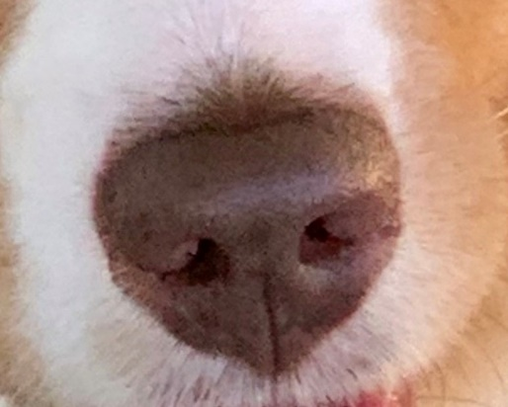
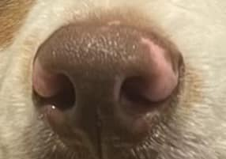
Nose
Blue merle and black tri’s have black pigmentation on the nose
Red merle and red tri’s have red (liver) pigmentation on the nose
Although fully pigmented noses are preferred, small pink spots
should NOT be faulted

Slide 19
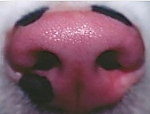
Too much pink?
Severe Fault
Disqualification
Fully pigmented noses are preferred
Severe Fault: 25-50% un-pigmented nose leather
Disqualification: Over 50% un-pigmented nose leather

Slide 20
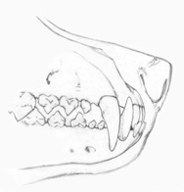
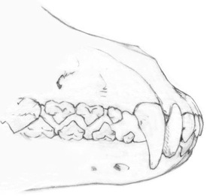
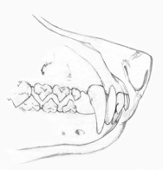
Teeth
Full complement of teeth
Scissor bite
Teeth broken, missing or discolored by accident are not penalized
Teeth Disqualification
Undershot
Overshot
Illustrations courtesy of Vicky Mistretta

Slide 21
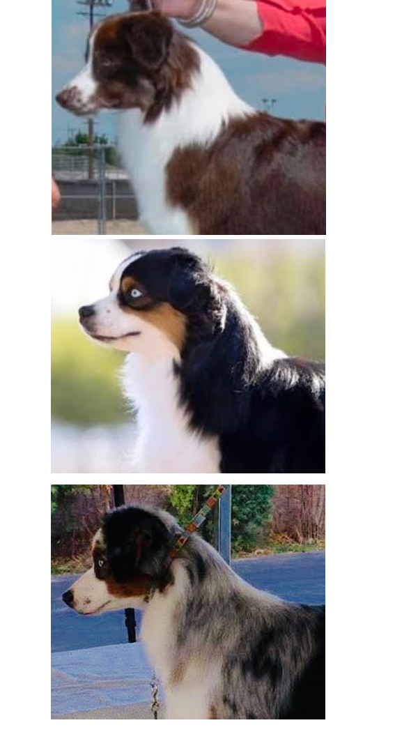
Neck
Firm and clean.
In proportion to the body
Medium length
Slightly arched at crest
Fitting well into the shoulders

Slide 22
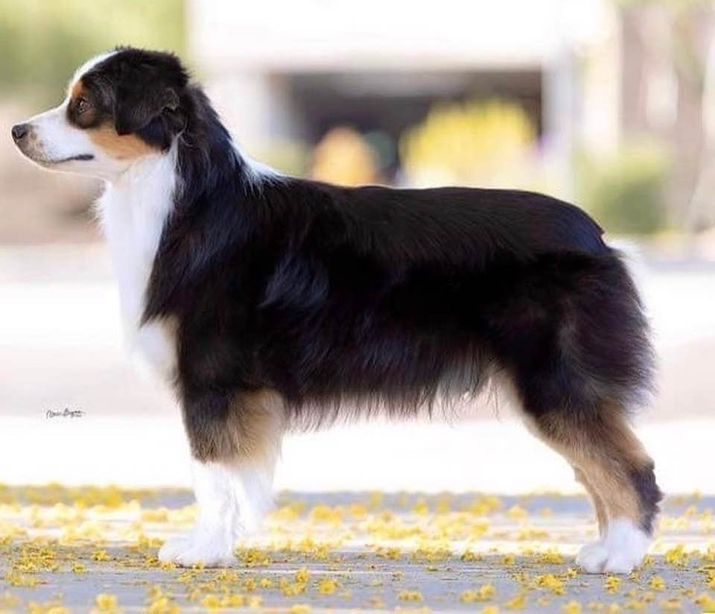
Topline and Croup
Firm and level
Loin strong and broad
Body is firm and well conditioned
Croup moderately sloped
The strength of the back is important.
The croup slope will be more apparent in dogs that are out of coat or carry less coat. If in doubt about a dog’s topline use your hands to feel what is under the coat.

Slide 23


Loin
The loin is strong and broad when viewed from the top
Illustrations courtesy of Vicky Mistretta

Slide 24

Chest, Ribs and Underline
Full and deep
Lowest point reaches the elbow
Well sprung ribs
They are neither barrel chested nor slab sided
The underline shows a moderate tuck-up

Slide 25

Tail
The docked or natural bobtail is preferred.
A docked tail is straight, not to exceed three (3) inches.
The undocked tail when at rest may hang in a slight curve.
When excited or in motion the tail may be carried raised with the curve accentuated.

Slide 26

Forequarters
Well conditioned and balanced with the hindquarters.
Upper arm (humerus) is equal in length to shoulder blade.
Attaches at an approximate right angle to the shoulder line
Shoulder blades long, flat, fairly close set at the withers, well laid back

Slide 27


Front
Forelegs drop straight and perpendicular to the ground
Legs straight and strong
Bone strong and oval

Slide 28



Elbow
The elbow joint is equidistant from the ground to the withers
Viewed from the side, the elbow should be directly under the withers
The elbows should be close to the ribs without looseness

Slide 29


Feet
Pasterns: Short, thick and strong, but still flexible, showing a slight angle when viewed from the side
Front and rear feet are oval
Compact
Toes close knit and well arched
Pads thick and resilient
Nails short and strong and any color
Dewclaws should be removed
Front
Rear

Slide 30

Hindquarters
Hindquarter angulation mirrors the forequarter angulation
Stifles clearly defined
Hindquarters width is approximately equal to the forequarter’s width at the shoulders
Illustrations courtesy of Vicky Mistretta

Slide 31


Hocks
Hocks are short
Perpendicular to the ground
Parallel to each other when viewed from rear
Rear dew claws should be removed
Illustration courtesy of Vicky Mistretta

Slide 32

Coat
Moderation is the overall impression of the coat
Hair is of medium texture, straight to wavy and weather resistant
Short and smooth on head, ears, front of forelegs and below the hocks
Moderately feathered backs of forelegs and britches
Mane and frill is more pronounced in males
The undercoat will vary in quantity according to climate

Slide 33


Presented Naturally
Trimming is allowed only on ears, feet, back of hocks, pasterns and tail.
Untrimmed whiskers preferred.
Shown in a natural coat.

Slide 34




Color
Blue Merle, Black, Red Merle, Red: with or without white or tan (copper) markings, with no order of preference
With no preference the merle will exhibit in any amount of marbling, flecks, or blotches
Asymmetrical markings are not faulted

Slide 35

Acceptable Color Variations

Slide 36


Tan markings
Not required
When present is acceptable around eyes, on feet, legs, chest, muzzle, under neck, face, inside ear underline, base of tail and breeches
Vary in shades from creamy beige to dark rust, with no preference
The Miniature American Shepherd should never be assessed based on lack of trim color or asymmetrical markings.

Slide 37


White Markings
A white collar is not required, but when present the hairline of a white collar does not exceed the withers at the skin
White is acceptable on neck (either in part or as a full collar) chest, legs, muzzle, underparts, blaze on head but does not predominate
A small amount of white extending from the underline may be visible from the side, not to exceed one inch above the elbow
Ticking may be present in white markings

Slide 38

White That is a Fault
Eyes that are not fully surrounded by color & pigment
White on the collar (at the skin) that exceeds the point of the withers
White on the underline that exceeds 1 inch above the elbow
White on ears that exceeds 25% of ear

Slide 39


Minimal Merle
Minimal merles do occur in our breed and may not look like a typical merle but will have a small patch of merle somewhere.
In cases where the merling is light, it is sometimes necessary to separate the hair and compare the patch to a known white area.

Slide 40


Gait from the Side
Smooth, free, and easy exhibiting agility of movement with a well-balanced, ground-covering stride
Agile and able to change direction or alter gait instantly

Slide 41


Gait from the Side #2
Well balanced gait with the back remaining firm and level
When traveling at a trot, the head is carried in a natural position with neck extended forward and nearly level or slightly above the topline

Slide 42




Coming and Going
Fore and hind legs move straight and parallel with the center line of the body
The MAS is not a single-tracking breed, but as speed increases, the feet, both front and rear, converge toward the center line of gravity

Slide 43

Must be Agile
Able to turn direction or alter gait instantly

Slide 44

Temperament
Exceptional companion and easily trained
Intelligent working dog of strong herding and guardian instincts
Protective, good natured, devoted and loyal
May be reserved with strangers but does not exhibit shyness
He is a resilient and persistent worker

Slide 45
Severe Faults
Prick ears & ears that hang with no lift
25-50% un-pigmented nose leather
Non typical coats
White markings exceeding 25% on ears

Slide 46
Disqualifications
Under 14 inches and over 18 inches for dogs; under 13 inches and over 17 inches for bitches. Minimum heights shall not apply to dogs or bitches under 6 months of age.
Over 50% un-pigmented nose leather
Undershot or overshot bite
Other than recognized colors.
White body splashes, between wither and tail, on back or sides between elbows and back of hindquarters.

Slide 47


Easy to Train

Slide 48





Playful Companion

Slide 49







Our dogs can and will do it all…
Herding
Agility
Disc Dog
Obedience
Conformation
Tracking
Dock Diving
Search & Rescue
Therapy
Farm Dog
Fast CAT
Nose work
Carting
And more

Slide 50

THANK YOU
That’s the end of our presentation…
BUTT, we hope you enjoy judging our breed!

